Slide 1
Volumes

Slide 2
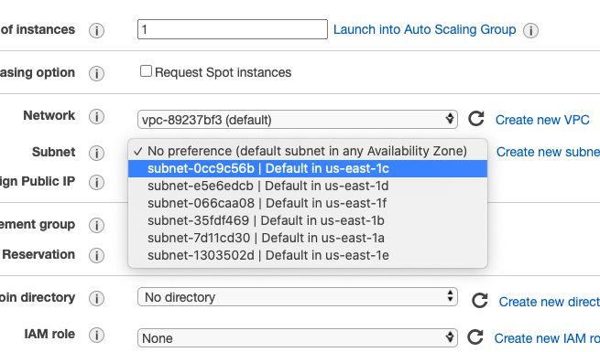
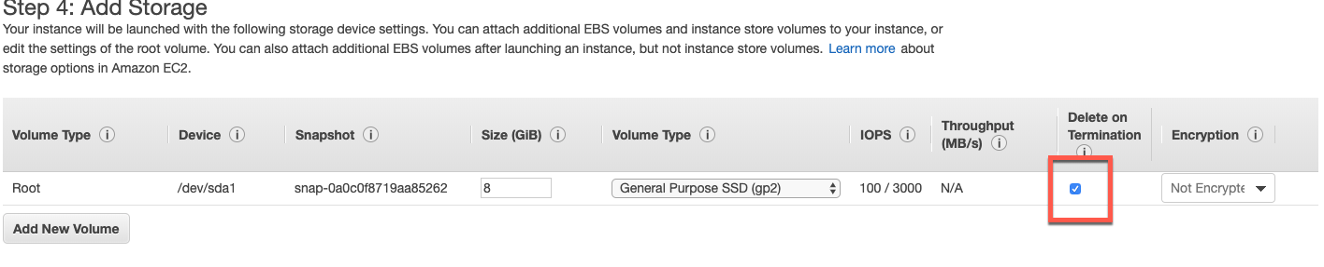
ENSURE THE REGION US-EAST1C
Create a new instance (Ubuntu)
Steps provided in AWS_Docker_V1.04.pptx
In Storage screen, uncheck the option for “Delete on Termination”
Note down the Device name (in this example it is /dev/sda1)

Slide 3
SSH into the new instance which we have just created

Slide 4
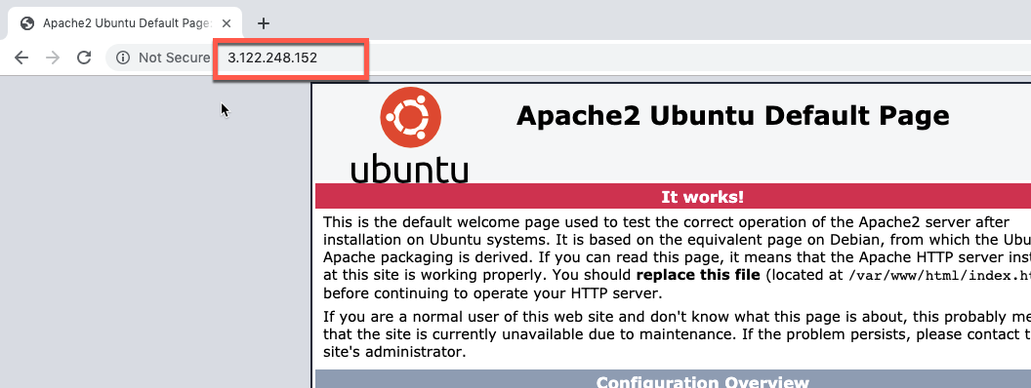
Install Apache
Putty/SSH
sudo apt-get update
sudo apt-get dist-upgrade (optional)
sudo apt-get install apache2
sudo a2enmod rewrite (optional)
Fire up the browser on the AWS IP to verify that Apache web server is up and running
(ensure security group is set for “All traffic”)

Slide 5
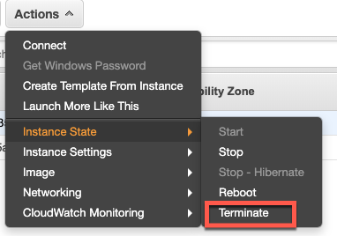
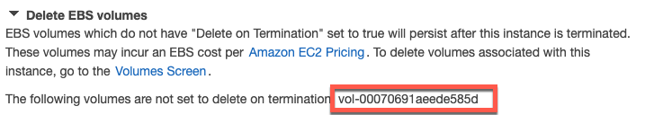
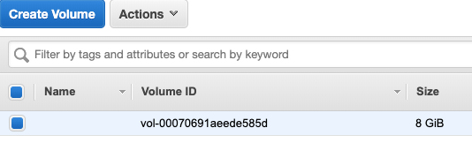
Click on Actions->Instance State->Terminate
In the confirmation window, expand “Delete EBS Volumes”
Click on Yes, Terminate button
Click on Volumes, We would notice our Volume present in the list (check the state of the volume) - DISCUSS

Slide 6
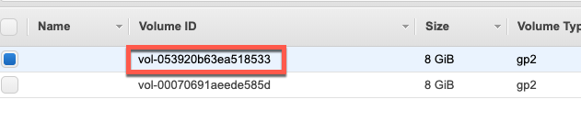
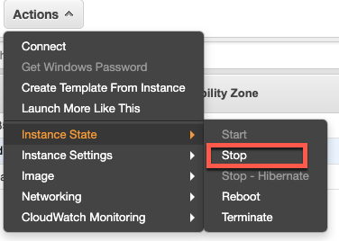
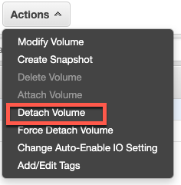
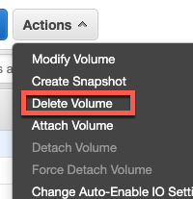
Create and Launch a new Ubuntu instance
Click on Volumes, We will see a new volume created
Click on Instances
Click on Actions->Instance State->Stop
Click on Volumes
Click on Actions->Detach Volume
Click on Yes, Detach button
Click on Actions->Delete Volume
Click on Yes, Delete button
ENSURE THE REGION US-EAST1C

Slide 7
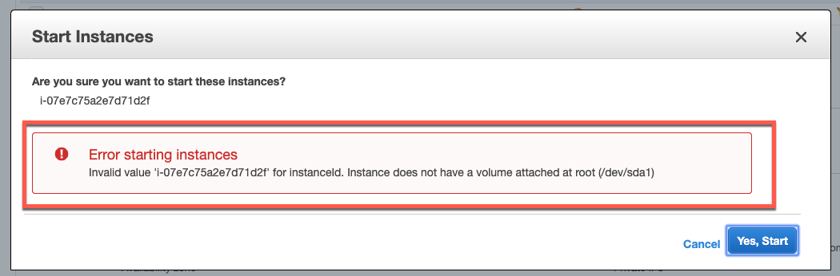
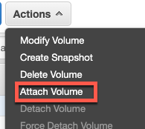
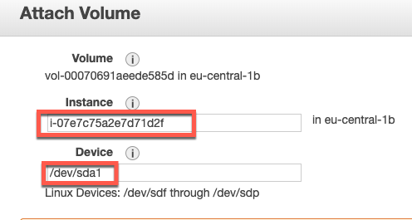
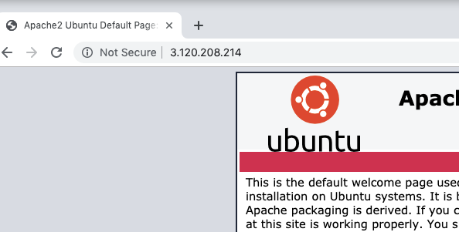
We will be unable to launch the instance, since it does not have any volume attached.
Click on Volumes tab view
Click on Actions->Attach Volumes
Select the instance in the Instance Drop down
Set device as /dev/sda1 (this we had noted down in first slide)
Click on Attach button
Launch the instance
Add security group for all traffic
Fire up the public IP on browser to see apache already running. If not - execute the following command
SSH to the instance and run the following command
systemctl start apache2.service

